Slide 1
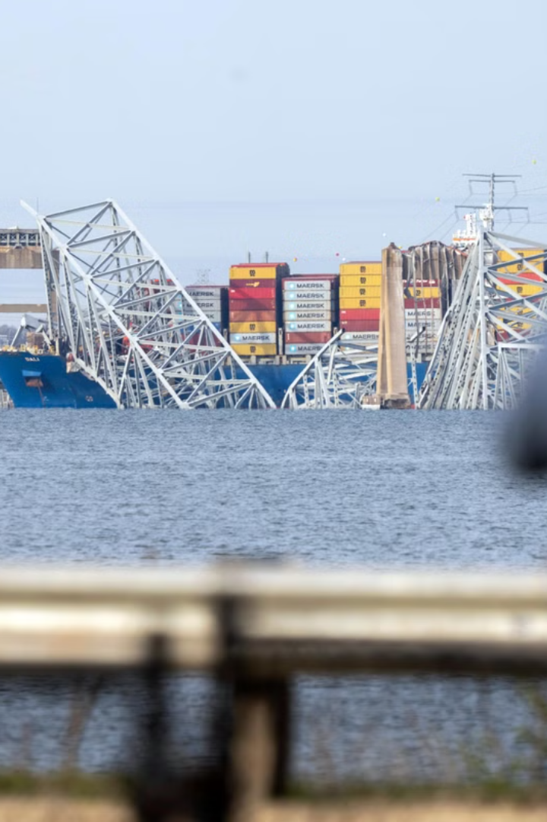
BridgeSense: Ensuring Bridge Safety
BridgeSense is a revolutionary technology that leverages advanced sensors to monitor bridge safety and prevent catastrophic accidents like the 2002 I-40 bridge collapse.
By: Arnav Kumar, Vick Maturu, Siddhartha Tamma

Slide 2
The 2002 I-40 Bridge Accident
The Crash
The Aftermath
In 2002, a freight barge struck a structural pier on the I-40 bridge, causing a catastrophic collapse. The collision occurred in the middle of the bridge.
The accident tragically resulted in the deaths of 14 people, including the barge operator, and caused significant disruptions to traffic.

Slide 3
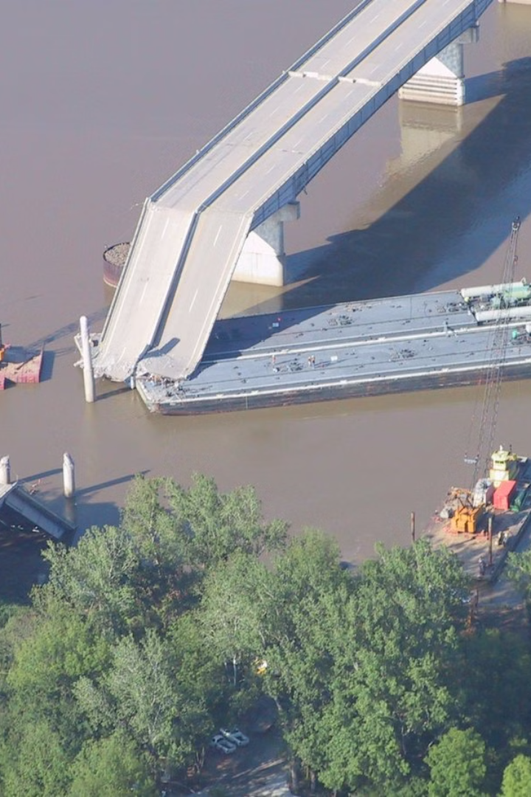
Tragedy on the Waterways
The Toll of Accidents
Lessons Learned
The I-40 accident underscored the vulnerability of bridges to unforeseen events, highlighting the need for proactive safety measures.
The tragedy served as a wake-up call for transportation authorities, prompting a renewed focus on bridge safety and infrastructure maintenance.

Slide 4
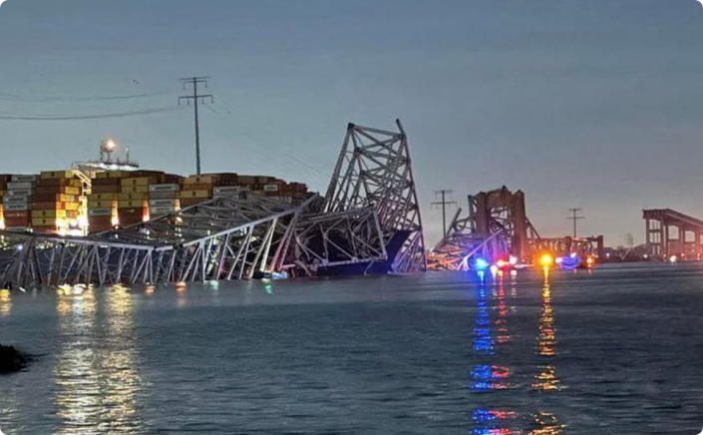
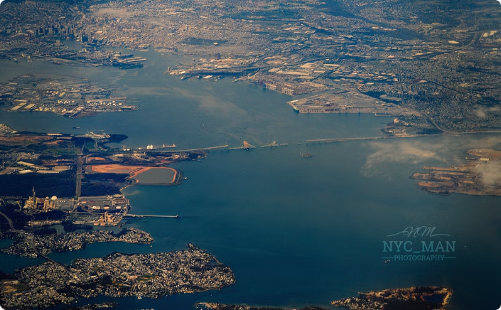
Lessons Not Learned…
Despite the devastating I-40 bridge collapse in 2002, structural integrity and safety measures remained inadequate. In 2024, the Francis Scott Key Bridge in Baltimore, Maryland, suffered a similar fate. On Tuesday, March 26, 2024, at 1:28 a.m. EDT (05:28 UTC), the main spans and the three nearest northeast approach spans collapsed after the container ship Dali struck one of its piers. Tragically, six members of a maintenance crew working on the roadway were killed, while two were rescued from the river. The collapse blocked most shipping to and from the Port of Baltimore for 11 weeks, resulting in an estimated economic impact of $15 million per day. Maryland Governor Wes Moore aptly described the event as a "global crisis."
Search & Rescue Teams searching for missing crew members and civilians.
Aerial View of FSKB Accident

Slide 5
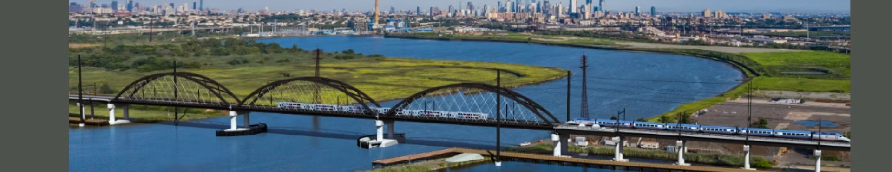
The Devastating Consequences
Loss of Life
Economic Impact
Safety Concerns
The accident tragically took the lives of 14 people, a stark reminder of the human cost of infrastructure failures.
The bridge collapse caused significant economic disruptions, impacting transportation networks and disrupting businesses.
The accident raised serious concerns about the safety of aging infrastructure and the need for preventative measures.

Slide 6
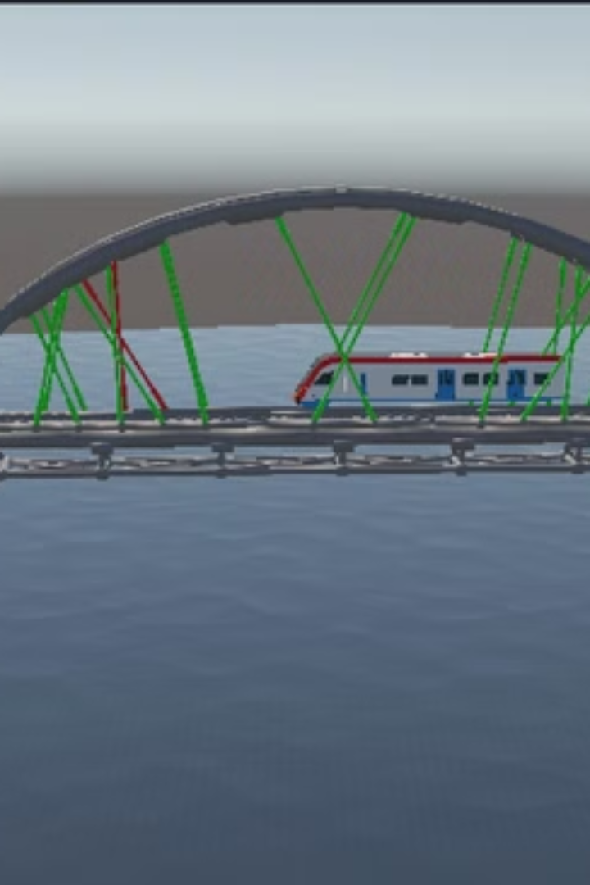


Detecting Bridge Structural Integrity
Real-Time Monitoring
Early Warning System
BridgeSense utilizes a network of sensors to continuously monitor key structural elements of bridges.
The system provides real-time data analysis, alerting authorities to potential issues before they escalate.

Slide 7

Studying Wind-Cable Interactions
1
Wind Analysis
BridgeSense models the dynamic interactions between wind forces and the cables of suspension bridges.
2
Simulation
Advanced simulations help predict how wind loads affect bridge stability, identifying potential vulnerabilities.
3
Mitigation Strategies
This data informs bridge design and maintenance strategies to minimize the impact of wind on bridge stability.

Slide 8
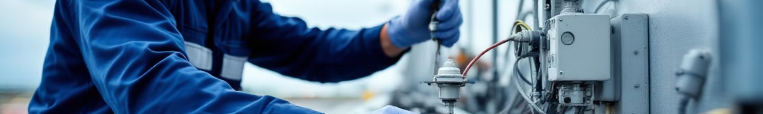



Leveraging Sensor Technology
Strain Gauges
Strain gauges measure the deformation of bridge structures under stress, providing critical data about their integrity.
Accelerometers
Accelerometers monitor vibrations and movements within the bridge, detecting subtle shifts that could indicate potential problems.
Weather Sensors
Weather sensors gather data on wind speed, direction, and temperature, providing context for interpreting structural behavior.

Slide 9
Technologies Behind BridgeSense
Frontend
Backend
Machine Learning
Streamlit (Dashboard UI) for creating user-friendly interfaces. HTML and CSS for embedding Unity WebGL for immersive 3D visualizations.
Flask (API for anomaly detection) to handle data requests and anomaly detection logic. Ngrok (For exposing local server to the web) to make our models accessible online.
Scikit-learn (Isolation Forest for anomaly detection) to identify unusual patterns in bridge data. Pandas and NumPy (Data processing) for efficient data manipulation.
3D Simulation
Deployment & Hosting
Unity (Digital Twin & Physics Simulation) for creating realistic 3D models of bridges and simulating their behavior. C# (Wind-based cable vibrations) and iTween (Train movement on bridge) for accurate physics.
Ngrok (Exposing Unity & Flask APIs) to make our models readily accessible to users. GitHub (Version control) to ensure collaboration and track changes.

Slide 10
Comprehensive Guide: AI-Powered Predictive Maintenance
1
Define the Scope
Identify core features, including IoT-based structural health monitoring.
2
Collect & Prepare Data
Gather IoT sensor data and prepare it for predictive maintenance models.
3
Develop AI Models
Train AI models for predictive maintenance, such as time-series forecasting.
4
Develop Digital Twin
Create a realistic 3D bridge simulation using Unity 3D.
5
Deploy the Solution
Deploy the system with edge AI for real-time monitoring and analysis.

Slide 11
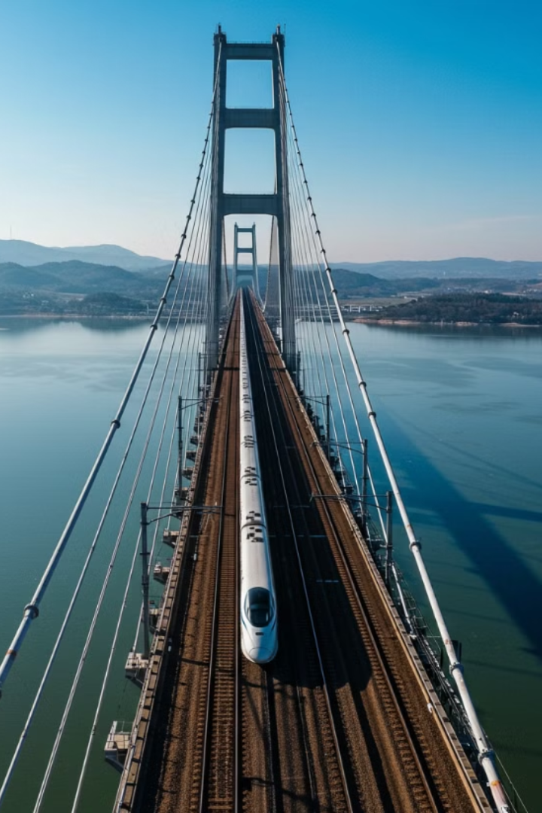
Conclusion and Next Steps
BridgeSense represents a paradigm shift in bridge safety, offering a proactive approach to prevent future tragedies. By continuously monitoring bridges and providing valuable insights, BridgeSense empowers authorities to make informed decisions and ensure public safety.

